Slide 1
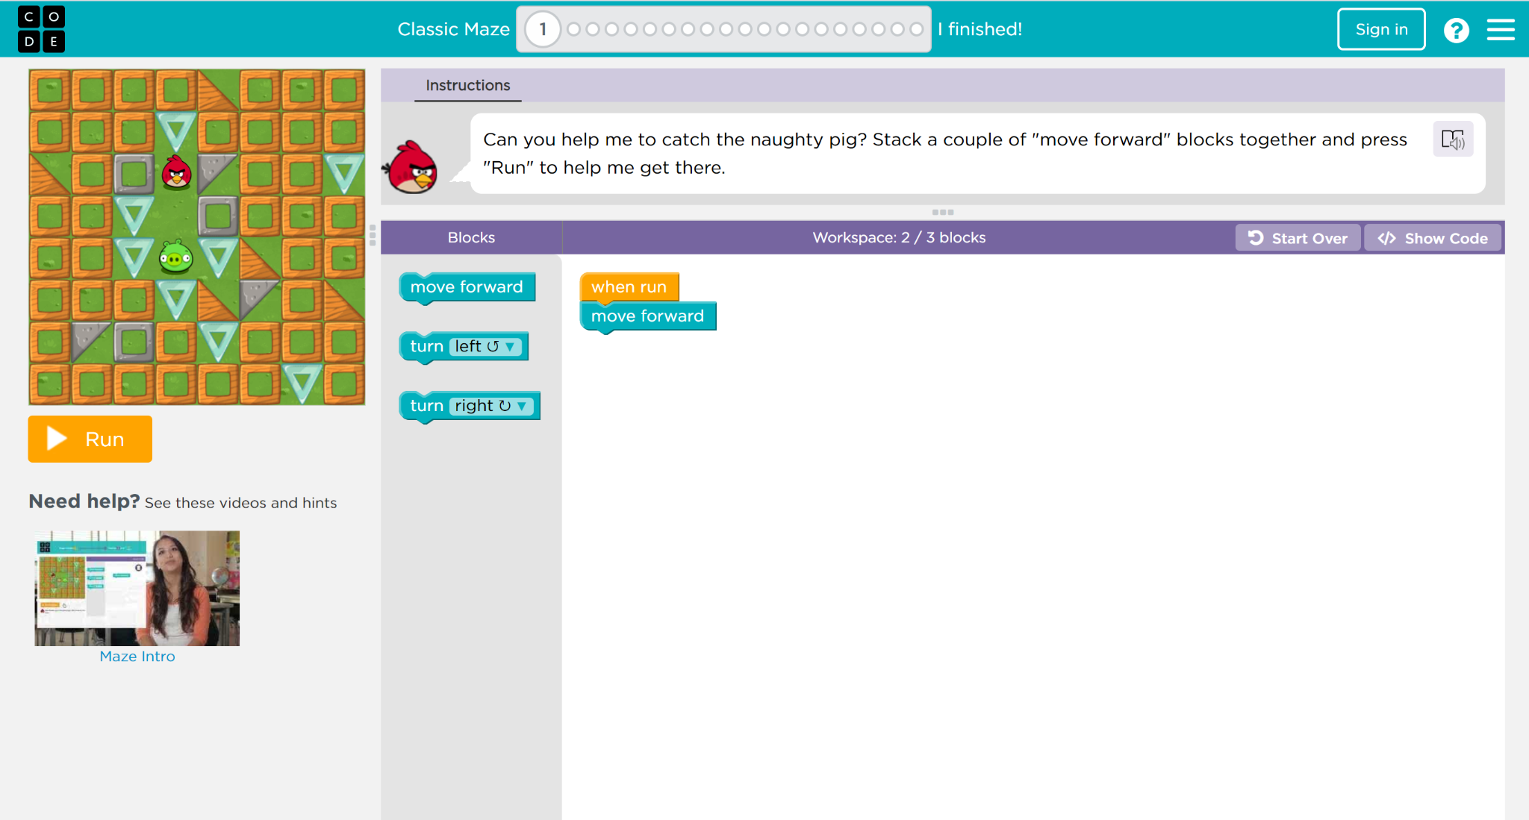
Birds Maze
Instructions for each level
Workspace where you will stack blocks
Run or Reset the Maze
Blocks (commands)

Slide 2

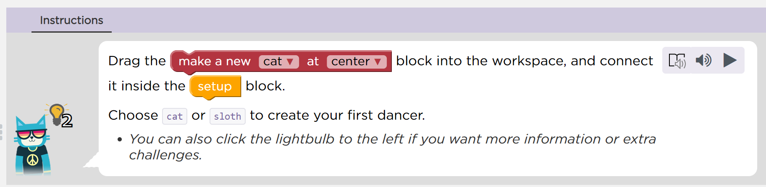
Read Aloud Options
Hints

Slide 3



